Slide 1

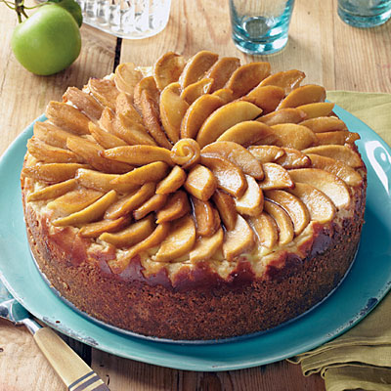
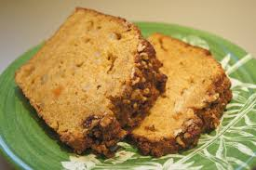
One-Day Baking-Class for Foreigners
· Time : July 16 (WED), 5:30 pm ~ 7:30 pm (for 2 hours)
· Gathering Place : IFEZ Global Center
(Please come to IFEZ Global Center by 5 pm ! We will take you to
the cooking place)
· Cooking Place : Songdo 2–dong Community Center
· MENU : Apple Pound Cake with almond
∙ Fee: \10,000
If you would like to attend
the cooking class, please let us know!
(032) 458-5790 or sina4205@iirf.or.kr

